Slide 1



ABC Call Volume Trend Analysis
Vivek Kushwaha

Slide 2
ABC Call Volume Trend Analysis
Description
Business Understanding
List Of Tasks
Assumption
Tech Stack Used

Slide 3
Project Description:
In this project, you'll be diving into the world of Customer Experience (CX) analytics, specifically focusing on the inbound calling team of a company. You'll be provided with a dataset that spans 23 days and includes various details such as the agent's name and ID, the queue time (how long a customer had to wait before connecting with an agent), the time of the call, the duration of the call, and the call status (whether it was abandoned, answered, or transferred). A Customer Experience (CX) team plays a crucial role in a company. They analyze customer feedback and data, derive insights from it, and share these insights with the rest of the organization. This team is responsible for a wide range of tasks, including managing customer experience programs, handling internal communications, mapping customer journeys, and managing customer data, among others. In the current era, several AI-powered tools are being used to enhance customer experience. These include Interactive Voice Response (IVR), Robotic Process Automation (RPA), Predictive Analytics, and Intelligent Routing. One of the key roles in a CX team is that of the customer service representative, also known as a call center agent. These agents handle various types of support, including email, inbound, outbound, and social media support. Inbound customer support, which is the focus of this project, involves handling incoming calls from existing or prospective customers. The goal is to attract, engage, and delight customers, turning them into loyal advocates for the business.
3

Slide 4
Business Understanding:
Advertising is a crucial aspect of any business. It helps increase sales and makes the audience aware of the company's products or services. The first impressions of a business are often formed through its advertising efforts. The target audience for businesses can be local, regional, national, or international. Various types of advertising are used to reach these audiences, including online directories, trade and technical press, radio, cinema, outdoor advertising, and national papers, magazines, and TV. The advertising business is highly competitive, with many players bidding large amounts of money to target the same audience segment. This is where the company's analytical skills come into play. The goal is to identify those media platforms that can convert audiences into customers at a low cost. In this project, you'll be using your analytical skills to understand the trends in the call volume of the CX team and derive valuable insights from it.

Slide 5
Tasks:
What is the average duration of calls for each time bucket?
Can you create a chart or graph that shows the number of calls received in each time bucket?
What is the minimum number of agents required in each time bucket to reduce the abandon rate to 10%?
Propose a manpower plan for each time bucket throughout the day, keeping the maximum abandon rate at 10%.

Slide 6
Assumption:
Assumption to be taken…
An agent works for 6 days a week; On average, each agent takes 4 unplanned leaves per month; An agent's total working hours are 9 hours, out of which 1.5 hours are spent on lunch and snacks in the office. On average, an agent spends 60% of their total actual working hours (i.e., 60% of 7.5 hours) on calls with customers/users. The total number of days in a month is 30.

Slide 7
Tech Stack Used:
Ms Excel: Helps in to gather , clean , removing duplicates and analyze data.
PowerPoint : Enables to present the findings in a clear and compelling manner.

Slide 8
Methodology:
Step 1: Data Collection
Step 2: Data Cleaning and Formatting
Step 3: Data Analysis
Step 4: Calculating Trends
Step 5: Building Your Presentation
Step 6: Data Visualization
Step 7: Explaining Insights

Slide 9
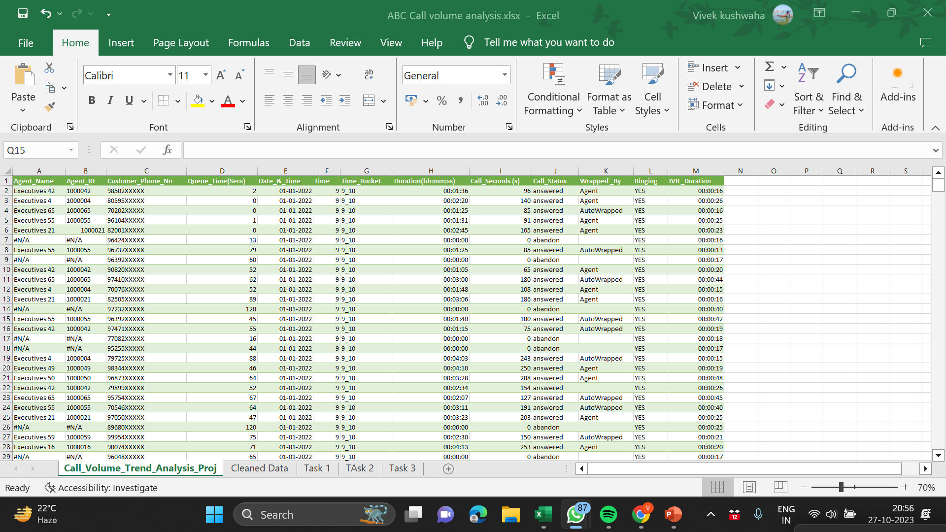
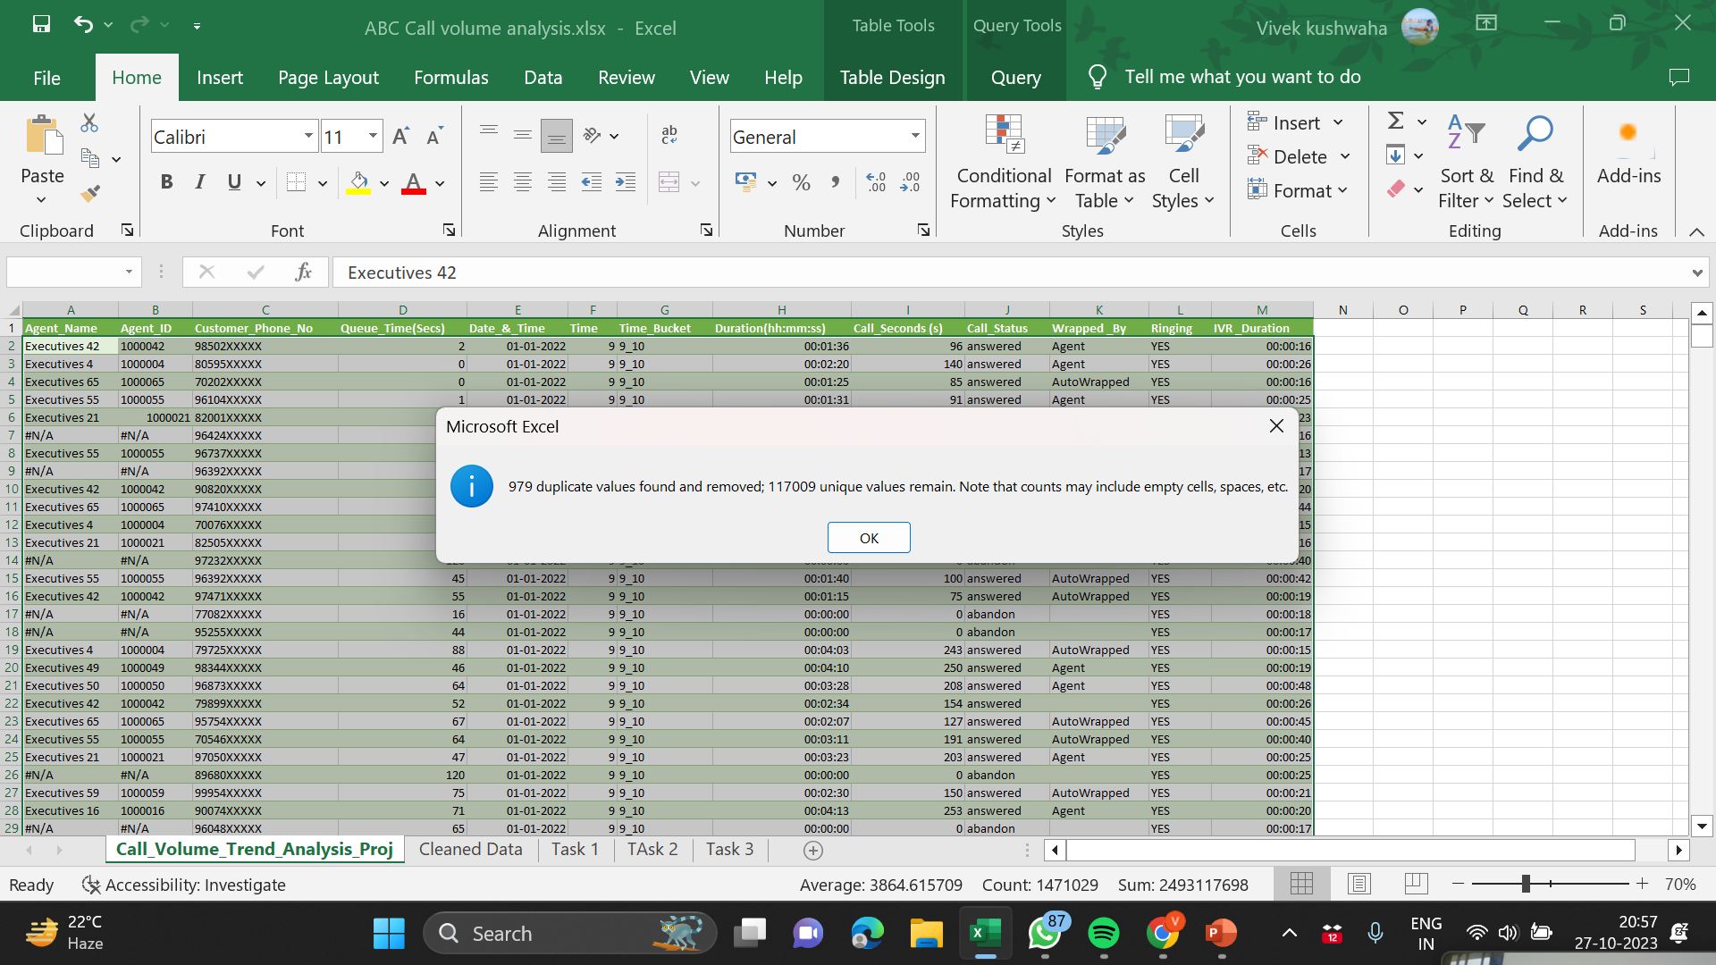
Data Cleaning:
Step1: Import Dataset
Step2: Find Duplicates

Slide 10
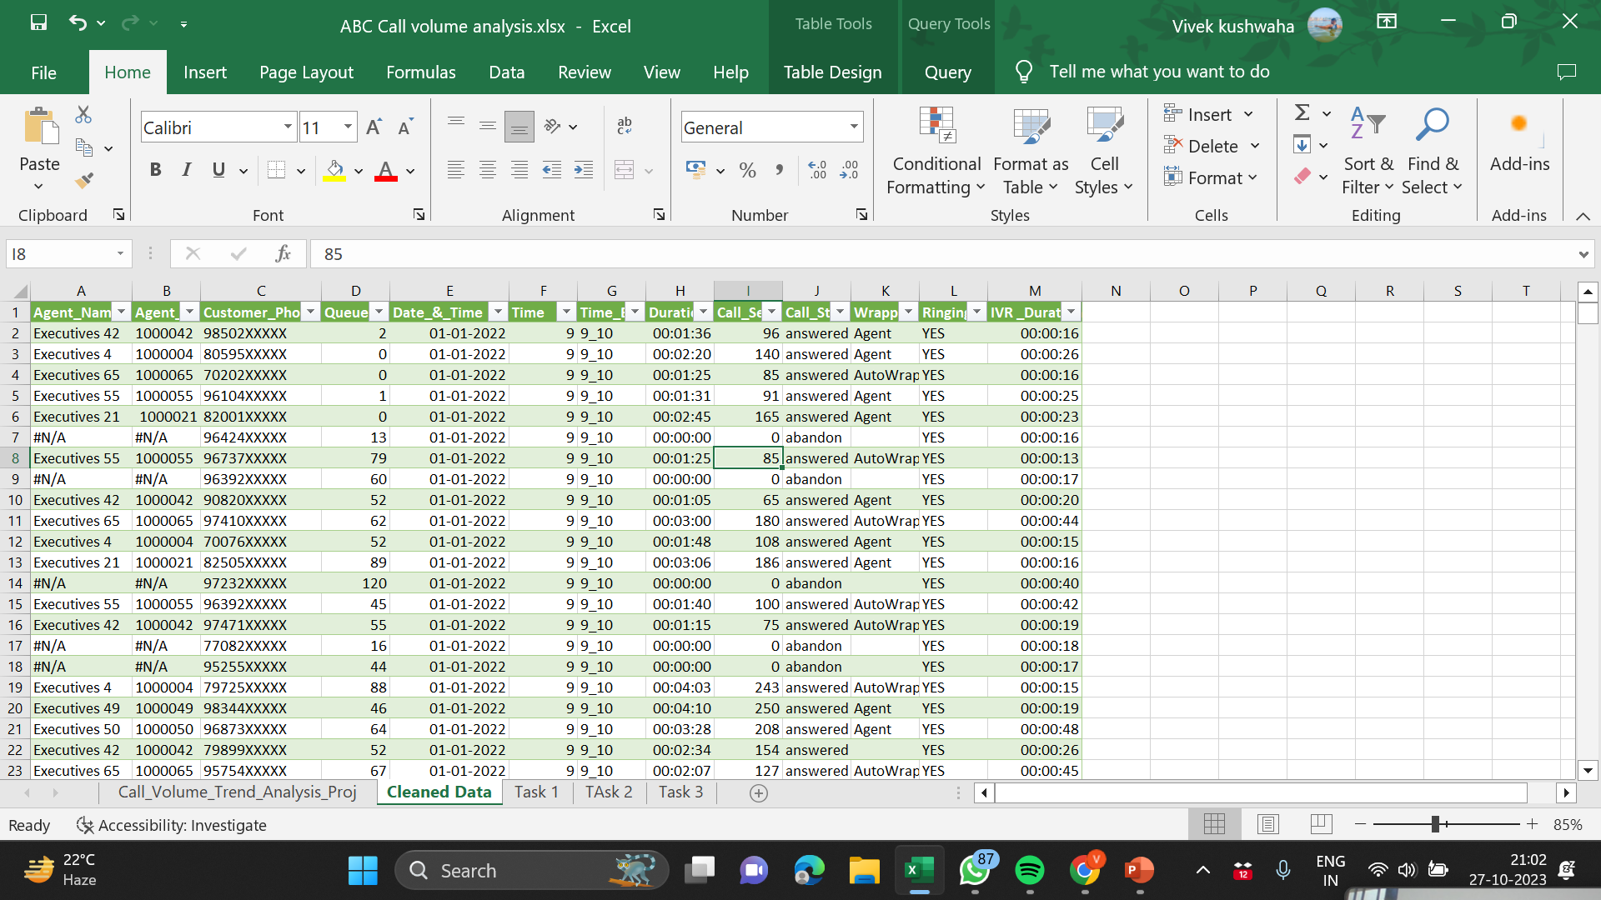
Cleaned Data:

Slide 11
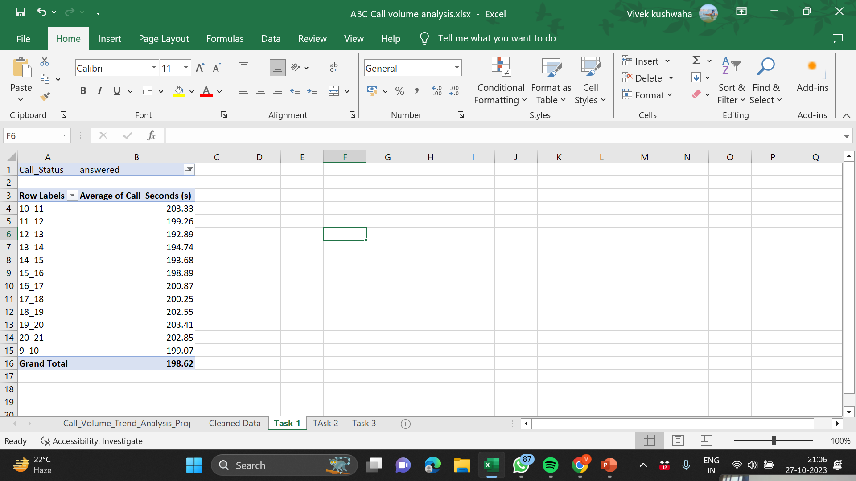
Task 1:
Average Call Duration: Determine the average duration of all incoming calls received by agents. This should be calculated for each time bucket.
Your Task: What is the average duration of calls for each time bucket?

Slide 12
Insights:
Highest Average of Call Seconds is 203.41 sec within time bucket 19_20.
It means mostly calls were made answered in between 19:00 PM – 20:00 PM.
Lowest Average of Call Seconds is 203.41 sec within time bucket 12_13.
It means mostly calls were made answered in between 12:00 PM – 13:00 PM.

Slide 13
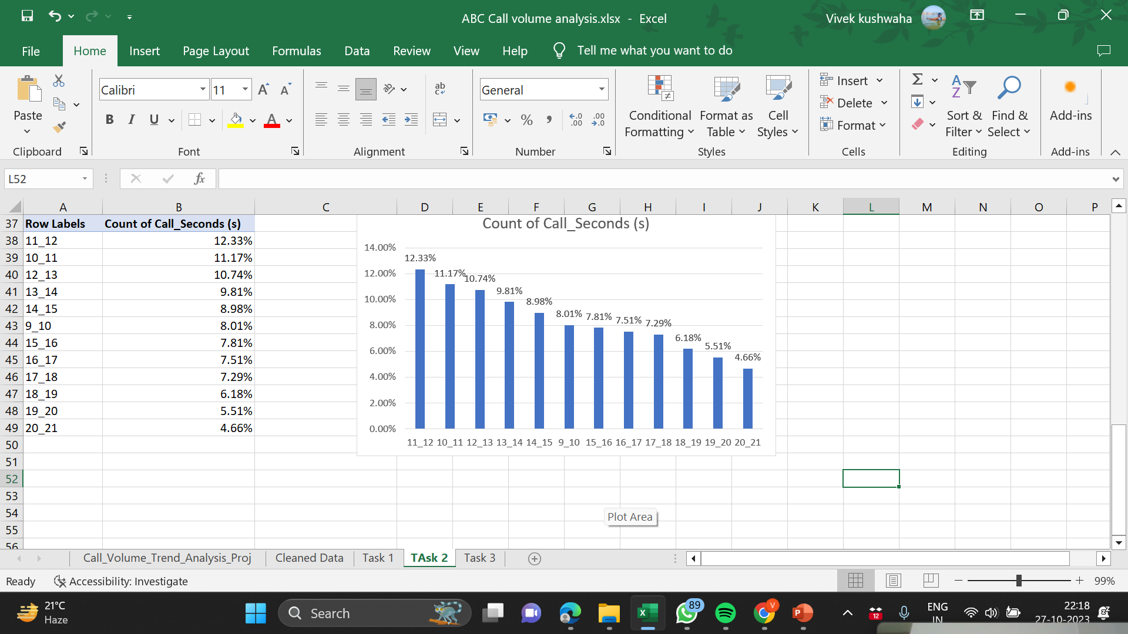
Task 2:
Call Volume Analysis: Visualize the total number of calls received. This should be represented as a graph or chart showing the number of calls against time. Time should be represented in buckets (e.g., 1-2, 2-3, etc.).
Your Task: Can you create a chart or graph that shows the number of calls received in each time bucket?
Total share in percent for incoming calls in each time bucket

Slide 14
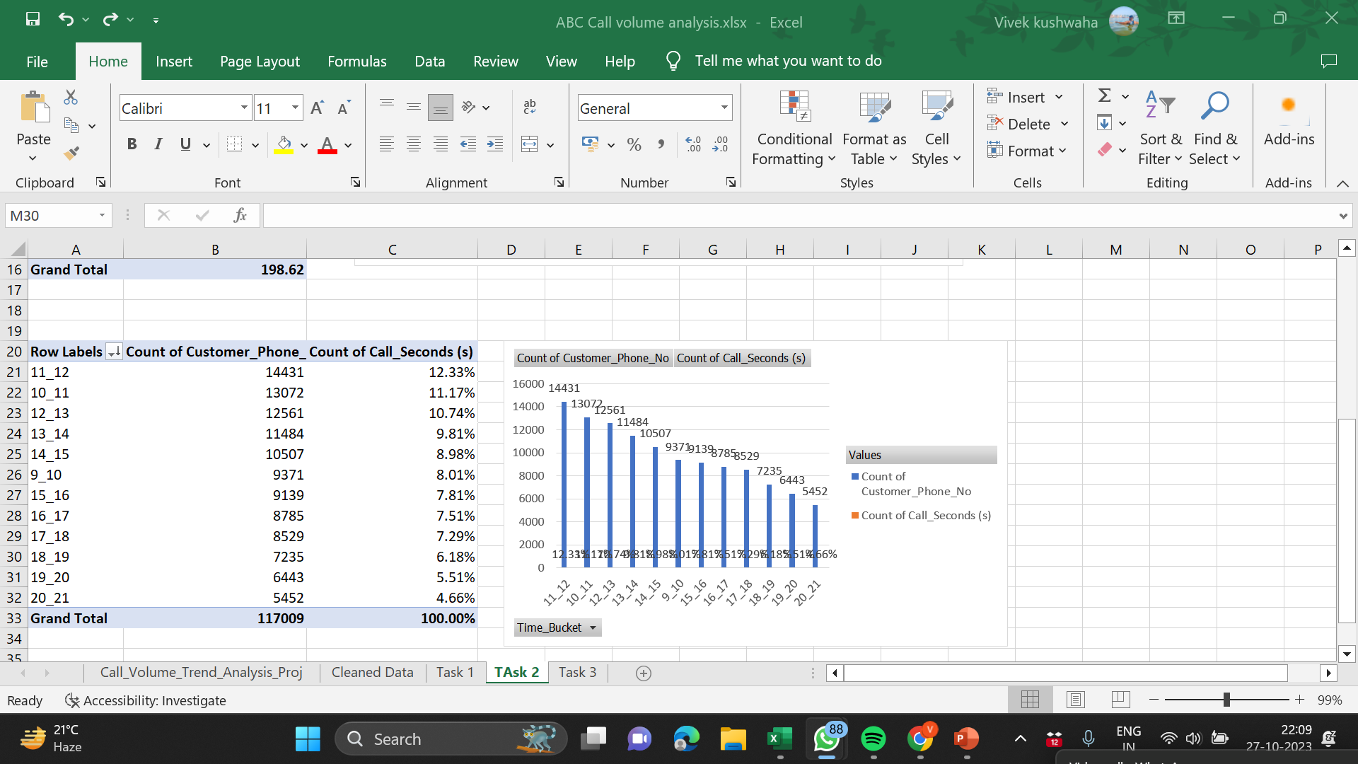
Calls received in each time bucket:

Slide 15
Insights:
From the above bar plot we can infer that time bucket 11_12 i.e. 11AM to 12PM has the highest count for total number incoming calls i.e. 14431.

Slide 16
Task 3:
Manpower Planning: The current rate of abandoned calls is approximately 30%. Propose a plan for manpower allocation during each time bucket (from 9 am to 9 pm) to reduce the abandon rate to 10%. In other words, you need to calculate the minimum number of agents required in each time bucket to ensure that at least 90 out of 100 calls are answered.
Your Task: What is the minimum number of agents required in each time bucket to reduce the abandon rate to 10%?

Slide 17
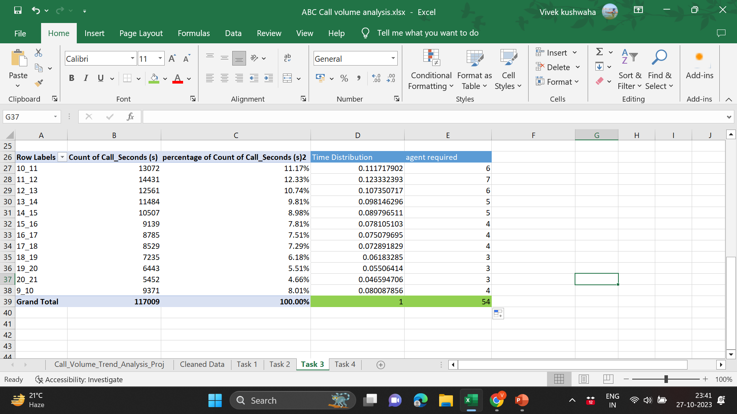

Slide 18
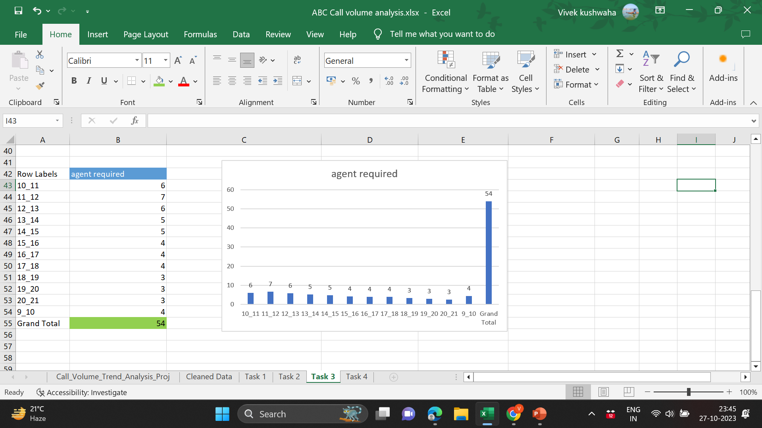
Insights:
The distribution of manpower plan per time bucket to keep abandon rate at 10% i.e. keeping call answered rate at 90% is

Slide 19
Task 4:
Night Shift Manpower Planning: Customers also call ABC Insurance Company at night but don't get an answer because there are no agents available. This creates a poor customer experience. Assume that for every 100 calls that customers make between 9 am and 9 pm, they also make 30 calls at night between 9 pm and 9 am. The distribution of these 30 calls is as follows :
Your Task: Propose a manpower plan for each time bucket throughout the day, keeping the maximum abandon rate at 10%.

Slide 20
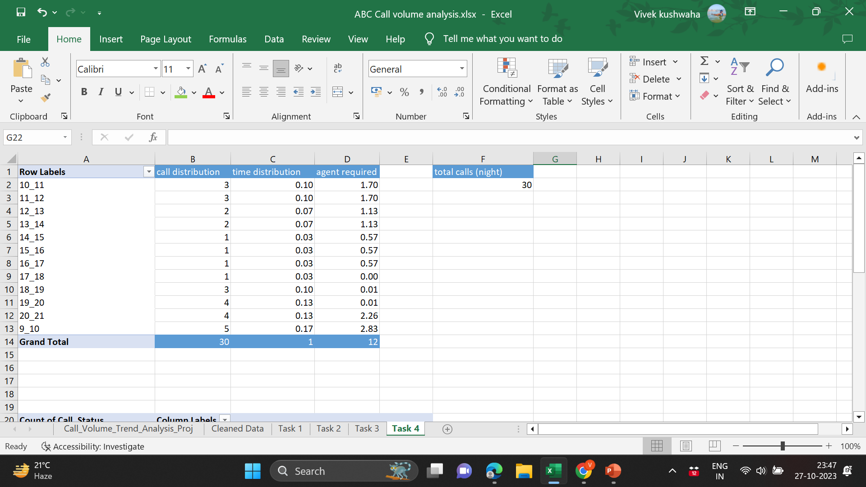

Slide 21
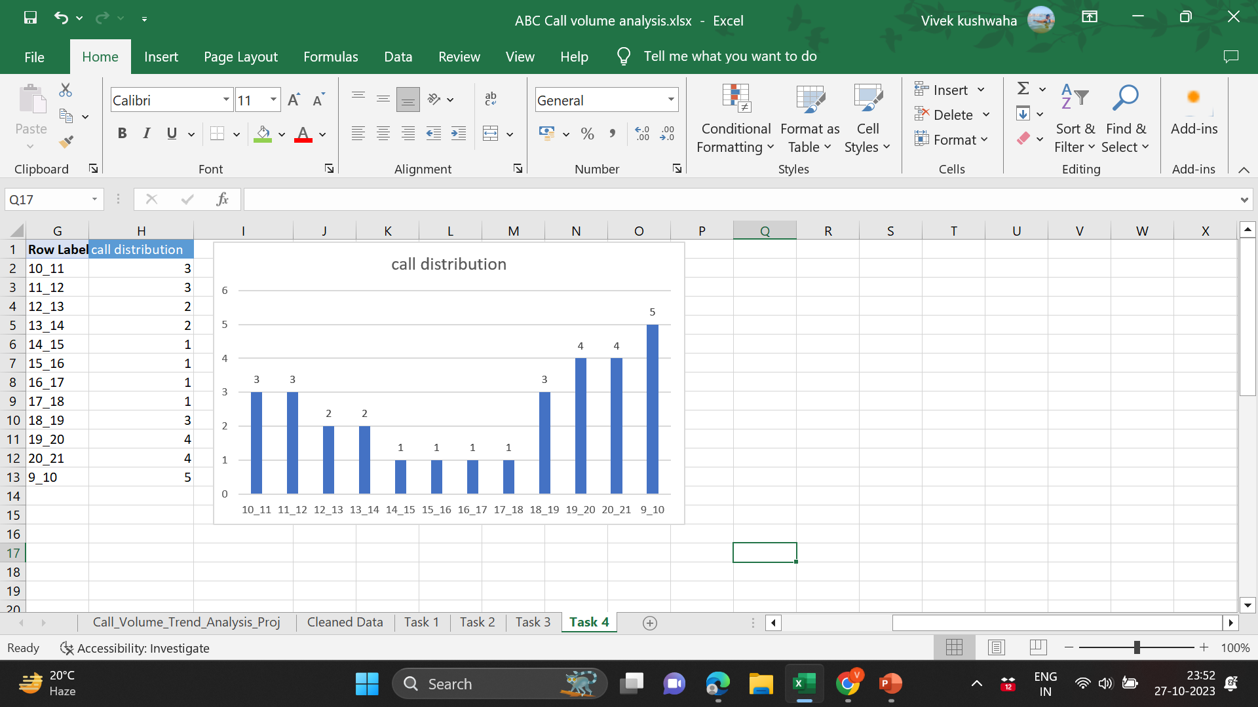

Slide 22
Insights:
The table above shows the desired distribution of the night calls to keep the abandon rate at 10%
Since we have only 12 agents during night we need to distribute in an non_Analytical way i.e. the agents who work in 19_20, 20_21 time bucket to wait and work in 21_22 and 22_23 time buckets as well
Also agents who work during 14_15, 15_16 time bucket can be asked to work for 7_8 and 8_9 time bucket as well
The agents who work in the time bucket 14_15, 15_16, 16_17 and 17_18 can be asked to work in time buckets 18_19, 19_20 and 20_21 so as to keep the abandon rate at 10% .

Slide 23
Excel file link:
https://docs.google.com/spreadsheets/d/1cpCvW8Ob_DYQeRvyIcG6QfHqxtcQ-Jeq/edit?usp=drive_link&ouid=107522417124927572865&rtpof=true&sd=true

Slide 24

Conclusion
Thus we have derived the insights for the company and understood the trends in the calling (Call center) Company
24

Slide 25




Thank you
Vivek Kushwaha
vivekkushawaha2020@gmail.com

